Slide 1
Grouping
Organizing Information
&
Gestalt Principles of Perception
Mostly from Heim Chapter 6.6 and usability.gov

Slide 2
Learning Outcomes
When and where is grouping critical in UI design?
What techniques can be used to sort things into groups?
How can you visualize the groups?
What visual clues can you use to indicate things belong together or apart?

Slide 3
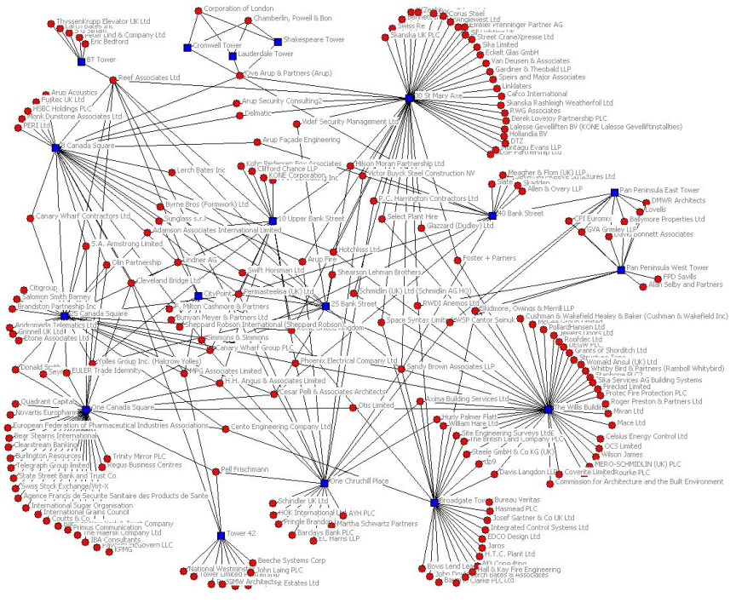
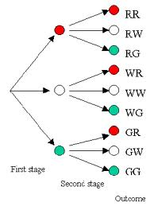
Information Architecture
Recap from Conceptual design (Lecture 8)
  If you have lots and lots of things to organize into a structure how can you do it?
  Hierarchy
  Network
  Tree

Slide 4
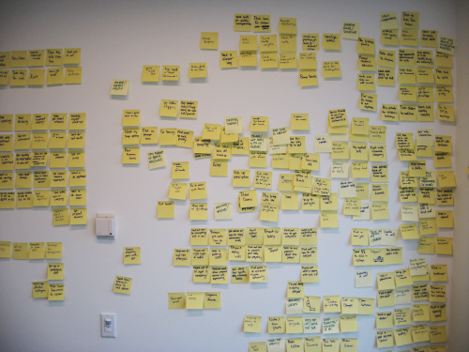
Card sorting
Card sorting is one of the most effective ways to group things.
Although there are software tools moving physical things around is easier! (and probably more effective)
http://www.usability.gov/methods/design_site/cardsort.html

Slide 5
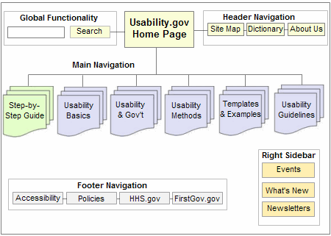
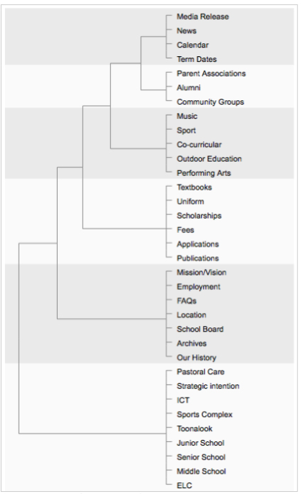
Site Map
The sort translates into
  Menu structure
  Site map
  http://www.usability.gov/methods/design_site/define.html

Slide 6
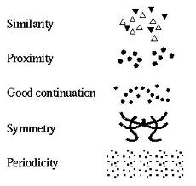
Grouping on a screen
Low-level principles - used to make decisions about specific screen controls, menus and layouts
Use visual cues to support the logical structure of the interface

Slide 7

Gestalt Principles of Perception
Gestalt psychology strives to explain the factors involved in the way we group things
At the heart of Gestalt psychology is the idea that we strive to find the simplest solutions to incomplete visual information (Prägnanz)
Figure-Ground: Basic premise
  We perceive our environment by differentiating between objects and their backgrounds

Slide 8
Gestalt Principles of Perception
  Proximity
  Similarity
  Common Fate
  Closure
  Good Continuity
  Area
  Symmetry
  Surroundedness
  Prägnanz

Slide 9
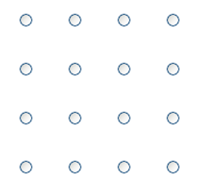
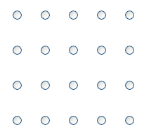
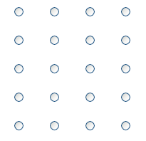
Gestalt Principles of Perception
Proximity Principle – Objects that are close to each other will be seen as belonging together
Equidistant | Horizontal Proximity | Vertical Proximity

Slide 10
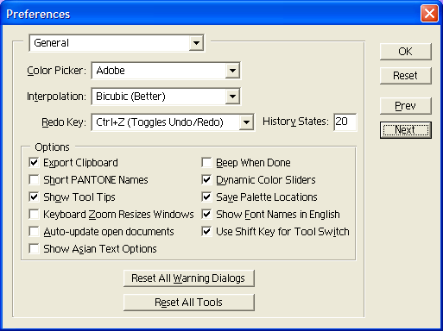
Gestalt Principles of Perception
Proximity - Adobe PhotoShop Preferences Dialog

Slide 11
Half time entertainment
http://www.nzherald.co.nz/business/news/article.cfm?c_id=3&objectid=11189192
Online news papers circa 1981

Slide 12
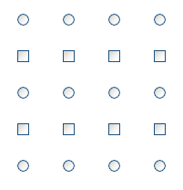
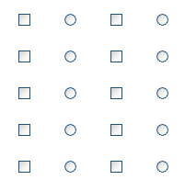
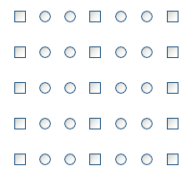
Gestalt Principles of Perception
Similarity Principle – Objects that have similar visual characteristics, such as size, shape or color will be seen as a group and therefore related
Rows of Similar Objects Columns of Similar Objects Grouped Columns

Slide 13
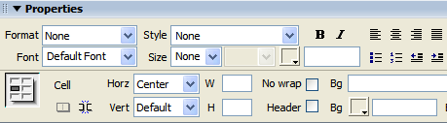
Gestalt Principles of Perception
Property Pane from Macromedia’s Dreamweaver
  Our eyes pick up all of the text boxes because of the strong blue squares and the white areas that they have in common

Slide 14
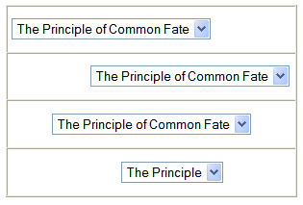
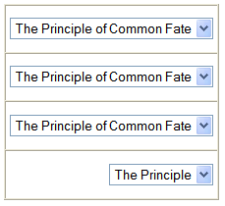
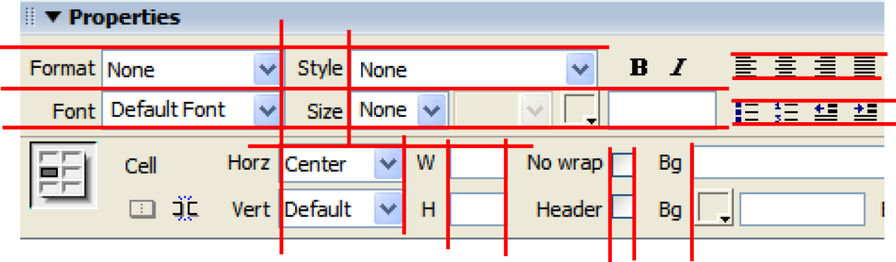
Gestalt Principles of Perception
Common Fate Principle – Objects that move together are seen as related
Unaligned Drop-Down Menus Aligned Drop-Down Menus

Slide 15

Gestalt Principles of Perception
Closure Principle – We tend to see things as complete objects even though there may be gaps in the shape of the objects
][ ][ ][
[ ] [ ] [ ] [

Slide 16
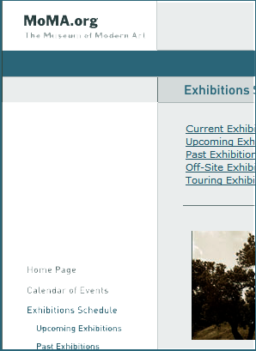

Gestalt Principles of Perception
Good Continuity Principle – We tend to see things as smooth, continuous representations rather than abrupt changes

Slide 17
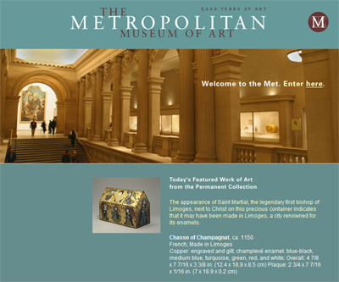
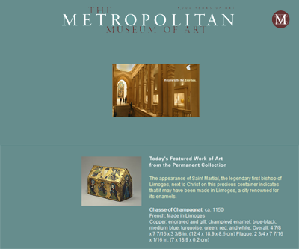
Gestalt Principles of Perception
The Area Principle – Objects with small area tend to be seen as the figure, not the ground (also called the smallness principle)

Slide 18



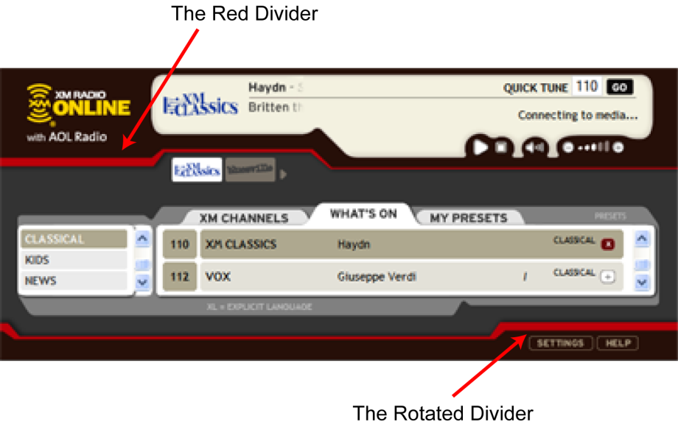
Gestalt Principles of Perception
Symmetry Principle – Symmetrical areas tend to be seen as complete figures that form around their middle
Translation Reflection Rotation

Slide 19
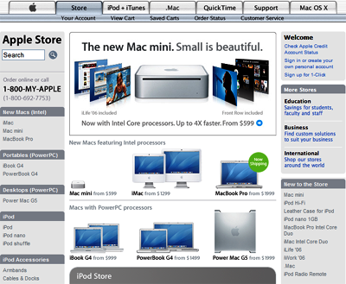
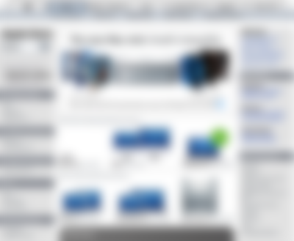
Gestalt Principles of Perception
Surroundedness Principle – An area that is surrounded will be seen as the figure and the area that surrounds will be seen as the ground

Slide 20
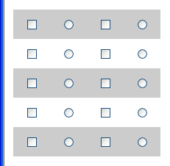
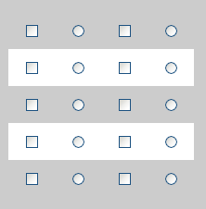
Gestalt Principles of Perception
Prägnanz Principle – We tend to perceive things based on the simplest and most stable or complete interpretation (the literal translation from German is precise).
Visual Conflict with Common Fate Visual Conflict with Surroundedness

Slide 21
Lines and borders
Are immediate visual clues to grouping
Lines, may be lines or changes in background colour
White space also has the same effect
More on this next lecture

Slide 22
Summary
When and where is grouping critical in UI design?
  Grouping happens at many levels and places
    Menus
    Sitemaps
    Pages
What techniques can be used to sort things into groups?
  Card sorts
How can you visualize the groups?
  Trees and hierarchy charts

Slide 23
Summary
What visual clues can you use to indicate things belong together or apart?
  The Gestalt Principles of Perception:
    Proximity
    Similarity
    Common Fate
    Closure
    Good Continuity
    Area
    Symmetry
    Surroundedness
    Prägnanz
  Borders and Lines
  Apply this in your assignment

